Slide 1
June 2026

Slide 2
Community Information Exchange
Purpose: To inform Command Family Readiness Representatives (CFRRs), Soldier & Family Readiness Groups (SFRGs), community leaders, and residents about upcoming events for Fort Bliss and El Paso (next 90 days). | Attendees: Chair: Garrison CDR OPR: USAG DFMWR BN/CO CFRRs/SFRGs WBAMC: CDR/Deputy Installation Agencies USAG Directorates & Support Offices School Liaisons City Representatives County Representatives | Agenda: Opening Comments: Garrison CDR Calendar Review: MWR Rep DFMWR Updates: MWR Rep BOSS DPW AAFES Two-Minute Drill Other Garrison / Installation Agencies City & County Update Question & Answers (30 Minutes) Closing Comments: Garrison CDR
Timing & Details: Frequency: Monthly, except DEC & JUL Time: 1 hour, 1200-1300, 3rd Wed Location: Centennial Conf Center Medium: Facebook & In-Person
 | Inputs: CG Decisions Bliss Synch Events Working Group Fort Bliss Ceremonies & Protocol Events Local Events & Community Relations
Primary POC: USAG: Ms. Alexis Escobar-Paz (DFMWR) | Outputs: Information for unit SFRGs Community Awareness & Advertising
COL Soyka, GCDR USAG FBTX , michael.v.soyka.mil@army.mil

Slide 3
Opening Comments
COL Soyka, GCDR USAG FBTX , michael.v.soyka.mil@army.mil

Slide 4
Outstanding Fort Bliss Soldier, Civilian & Spouse
COL Soyka, GCDR USAG FBTX , michael.v.soyka.mil@army.mil

Slide 5


Upcoming Events
June 27, 4pm @ Biggs Park
FREE – open to all ages
Enjoy 8 days of fun as we begin America’s 250th Birthday celebrations here at Fort Bliss & end it in Downtown El Paso!
SAVE THE DATE:
August 22, 5-8pm @ Centennial
Open to ages 18+
Put in a song request and watch as it is dueled out on the pianos!
COL Soyka, GCDR USAG FBTX , michael.v.soyka.mil@army.mil

Slide 6
MWR Programs
Highlight
Ellie Oschwald, Executive Officer – MWR, ellie.k.oschwald.naf@army.mil
6

Slide 7

Army Community Service
Ellie Oschwald, Executive Officer – MWR, ellie.k.oschwald.naf@army.mil
7

Slide 8

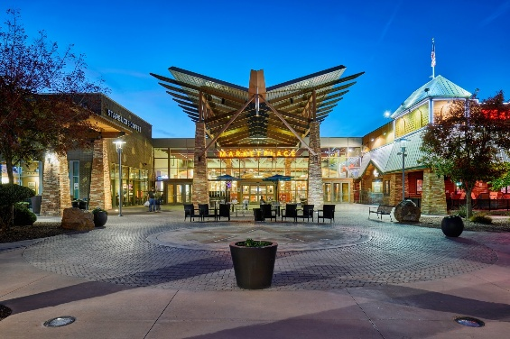
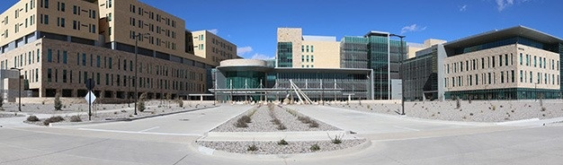
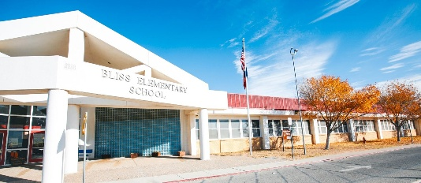
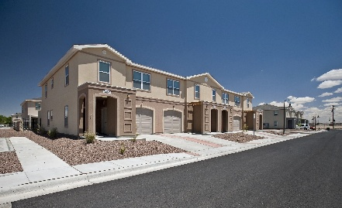
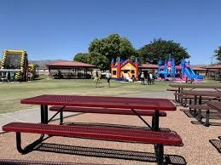
Newcomer Spouse Tour – JUL 2026
Audience | Spouses of SMs and Civilians recently arrived at FBTX
Guide | Volunteer senior spouses, CFRRs
Transportation | 15-PAX van/bus
Duration | 50-60 minutes
Locations (Tentative) | Housing Office CDC 1AD Chapel Biggs Park WBMC SSC/DEERS Freedom Crossing Mendoza Clinic MWR Building Stout Gym ACS Building Schools
Frequency | Weekly; morning of each Newcomer Brief (starting in JULY)
Advertising | MWR Social Media ACS Social Media Newcomer’s Briefs CFFRs
MAJ Chet Garner, chester.t.garner.mil@army.mil
8

Slide 9
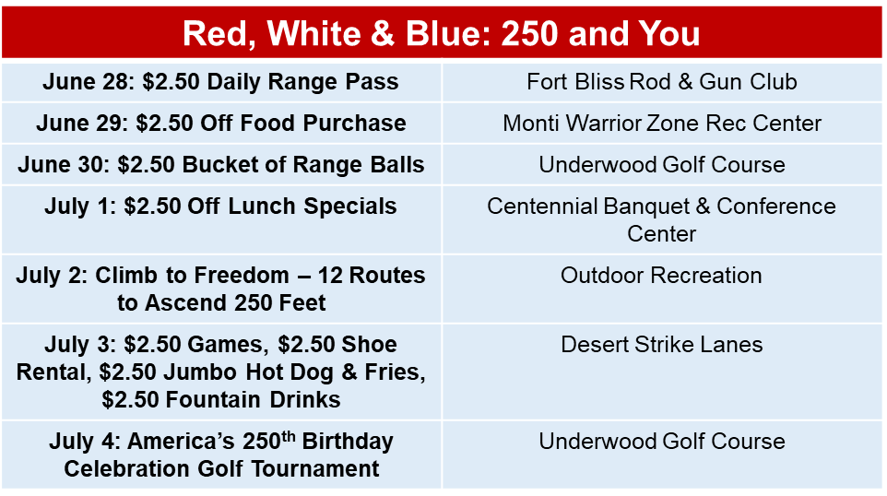

Events
30 DAYS
JUN 20: Rifle Battleship
June 20:The Market EP
June 20: The Jazz Exchange
JUN 20: Totally Rad Vintage Fest
JUN 20: La Fe Father’s Day 5K Run and Walk
JUN 21: Father’s Day Bowling Special
JUN 21: Father’s Day Brunch
JUN 26: Cool Canyon Nights
JUN 27: 915 Card Show
JUNE 27: Pop Goes the Fort
July 2nd: Climb For Freedom
JULY 4: America 250
JULY 4: Fourth of July Golf Tournament
JULY 11: Run for Freedom
JUL 11: Ten-Miler in the Heat
JUL 11: Kayak The Rio
ONGOING
100 Mile Swim Club
Parent & Child Swim Lessons
Hiking & Biking Challenge
Fort Bliss Events
El Paso Events
After School Hangout at the Library
Home School Board Game Days at the Library
AER Campaign
Commander’s Cup Softball League
Alexis Escobar-Paz | MWR Marketing Specialist | 915-568-3805 | alexis.m.escobar-paz.naf@army.mil
9

Slide 10


Events
60 DAYS
JULY 18: Night Trap Shoot
JULY 18: River Float Trip
JULY 30: KA-RAY-OKE @ The Elmont
JULY 31: Climbing Clinic
AUG 1: Kids Day On The Wall
AUG 8: Cardboard Regatta
AUG 15: Harry Potter Festival
AUG 15: Muscles Feast
AUG 15: Wine Tour
ONGOING
Los Besties Social Art Club
100 Mile Swim Club
Parent & Child Swim Lessons
Hiking & Biking Challenge
After School Hangout at the Library
Home School Board Game Days at the Library
AER Campaign
Commander’s Cup Softball League
Fort Bliss Events
El Paso Events
Alexis Escobar-Paz | MWR Marketing Specialist | 915-568-3805 | alexis.m.escobar-paz.naf@army.mil

Slide 11



BOSS Programming
June
RECURRING EVENTS
30 Mental First Aid (MHFA) Training
2/1 Green PLT Brief ( Brigade Rep Lead Weekly )
Barracks QOL Meeting
DFAC QOL Meeting
Newcomer’s Brief (Weekly)
Tour De Bliss ( Weekly Wed & Fri )
Iron Zero Friday & Saturday (2200-0400)
OTHER EVENTS
20 Pirate Pool Party
20 Key Ceramony for SSG Pascual
27 Pop Goes the Fort Vol
July
RECURRING EVENTS
7 BOSS Monthly Meeting
5 Rescue Runners
15 Theater Thunder
11 El Paso Community Clean up * NEW DAY *
28 Mental First Aid (MHFA) Training
2/1 Green PLT Brief ( Brigade Rep Lead Weekly )
Barracks QOL Meeting
DFAC QOL Meeting
Newcomer’s Brief (Weekly)
Tour De Bliss ( Weekly Wed & Fri )
Iron Zero Friday & Saturday (2200-0400)
OTHER EVENTS
04 EP America 250 Vol
18 RWB Pool Party
20-24 Scuba Week Life Skill ( PENDING )
25 Explore Roswell
August
RECURRING EVENTS
4 BOSS Monthly Meeting
2 Rescue Runners
11 Theater Thunder
08 El Paso Community Clean up * NEW DAY *
25 Mental First Aid (MHFA) Training
2/1 Green PLT Brief ( Brigade Rep Lead Weekly )
Barracks QOL Meeting
DFAC QOL Meeting
Newcomer’s Brief (Weekly)
Tour De Bliss ( Weekly Wed & Fri )
Iron Zero Friday & Saturday (2200-0400)
OTHER EVENTS
01 CWST Class
15 BOSS Bark & Barrel LTC Class
18 The "No-Paws" Pool Party
J. Skillern, 915-744-1529, patricia.a.skillern.naf@army.mil
11

Slide 12
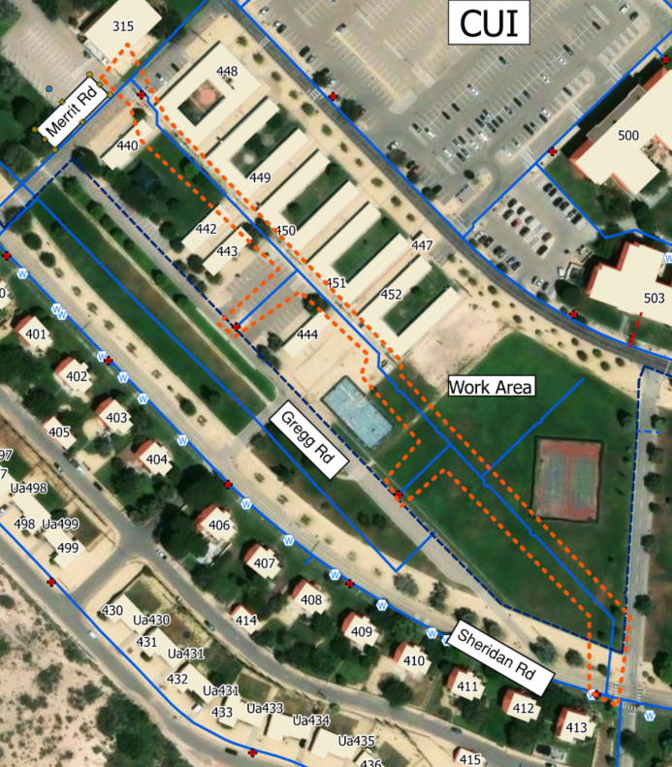
Directorate of Public Works (DPW)
Area 400 WL R&R
POC: Duston Horacek (602) 628-1366
Project: Area 400 WL
  FBWSC working on installation of new potable water distribution system to replace existing deteriorated infrastructure.
Road Impacts:
  Sheridan Rd & Merrit Rd
  Closures to be coordinated in advance with DPW & DES
  Closures should only last a few days each
Construction Schedule
  Starting approx. July 2026
  Ending approx. October 2026
Duston Horacek, FBWSC, Duston.Horacek@asusinc.com , (602) 628-1366
12

Slide 13

The Exchange
Main Store
  Father’s Day “Your Hero” Celebration- 20 June from 1300-1430
  Summer Solstice Celebration- 27 June from 1300-1500
  Independence Day Celebration- 04 July 1300-1500 Our Main Store will also be celebrating World Chocolate Day and National Grill Month on this day.
Freedom Crossing
  Rise 915 Market 26 July from 1700-2100
Kelly Tolefree-Sarmiento– GM 915-562-8851 X 202 tolefreesarmiento@aafes.com

Slide 14
Alibis & Announcements
Two-Minute Drill per Speaker
CYS
WBAMC
RSO
DECA
MOAA
COL Soyka, GCDR USAG FBTX , michael.v.soyka.mil@army.mil

Slide 15

CYS – Parent Central
Registration Documents:
Immunizations: Birth-Preschool and Home Schooled
Current Health Assessment/Sports Physical (we give you 30 days to get one completed)
Two LOCAL emergency contacts
DEERS 1172/ ID card/ Birth certificate
Registration Tool
15

Slide 16
Patient Information
William Beaumont Army Medical Center
School and Sports physicals will be available at the Mendoza Clinic 29 May to 30 July 2026; call the appointment line to schedule (915-742-2273). Please bring the necessary physical forms.
Patient and Family Partnership Council will be August 20, 2026 at 10:30 a.m. in the WBAMC Executive Dining Room
There are several Red Cross Volunteer opportunities available at the hospital. Call 915-742-9433 or email bliss@redcross.org
EFMP information briefs are held every 2nd & 4th Thursday of the month at 1:00 p.m. at the WBAMC West Clinic 3rd floor HR Conference Room (#W3414).
The Soldier Family Medical Center is closed for repairs. Please visit our website for the temporary locations for your primary care and ancillary care services. https://william-beaumont.tricare.mil/Clinics/Soldier-Family-Medical-Center-West-Bliss
Service Degradation – With the upcoming PCS season, please be aware that services provided within the MTF may fluctuate. We strive to provide quality, continuity, and safety to all of our patients and staff. We will communicate any changes that affect access to care promptly.
Kristal Pinkney, 915-742-3878, kristal.a.pinkney.civ@health.mil
16

Slide 17
Religious Support Office (Chaplain)
Upcoming Events 13-17JUN – Vacation Bible School – 0900-1300 21JUN – Father’s Day BBQ (CC1) – 1000 08JUL – Splash Pad Meetup @ Biggs Park 21JUL – Coffee & ChitChat @ Freedom Crossing Starbucks 26JUL – Summer Book Club @ Rachel McClure’s House 30JUL – 251st US Army Chaplain Corps Anniversary – 0900-1300 5th Sunday – Family and Friend Day (Gospel Service) Ongoing Activities/Ministries: Operation Helping Hand allows the RSO to provide crisis support to Soldiers throughout the year, as emergencies arise in their lives. This is an opportunity for Soldiers to help Soldiers, no matter their rank or position. AWANA - Sunday @ 1600 Family Life Chaplain Center – new location (449 Pershing Road) Proverbs 22:6 (FBHA), including monthly field trips and other activities PWOC Women’s Bible Study and Fellowship Tuesday @ 0900
For Virtual Religious Services and most
Updated worship service schedule, please call 915-568-1519
CH Kimble, Bryan, 254-317-9057, Bryan.S.Kimble.mil@Army.mil
17

Slide 18

Fort Bliss Commissary
CIE Information
Juneteenth – June 19: The Commissary will be open during regular operating hours,
0800–2000. Be sure to stop by and take advantage of our great prices on fresh meats
and all your summer grilling favorites!
Engaging with Field Engineer on proposed new outdoor New Main Entrance signage to enhance curb appeal!
New registers, self checkouts, and systems are schedule to be installed September of this year.
Be on the look out for B.A.B.s our Better at Bliss robo saver. He knows all the best prices in town.
Grocery formal inventory: 7/14/26-7/15/26 This will not effect store operations.
BlissCo: Planned for after our formal inventory. Date TBD (possibly first week of August).
Church & Dwight Savings Event: Visit our Church & Dwight display located near the
self-checkout area and enjoy extra savings on popular household essentials,
including Arm & Hammer laundry products.
Fresh-Cut Produce: Looking for a healthy, refreshing snack?
Check out our selection of fresh-cut fruits in the Produce Department.
Prepared multiple times throughout the day for maximum freshness and convenience.
Beat the Heat: Your Fort Bliss Commissary has our Summer Beverage campaign down Aisle 1.
Home Delivery Grocery Service: Grocery delivery continues to grow in popularity,
now accounting for 15.2% of Click2Go sales
Herby Berryhill Jr., Commissary Officer, 915-600-1385, Ext. 3001, herby.berryhill@deca.mil.

Slide 19


MOAA EL PASO CHAPTER
70TH ANNIVERSARY INITIATIVES
MOAA
MOAA EL PASO CHAPTER
70TH ANNIVERSARY INITATIVES
NEXT LUNCHEON 13 JUNE 2025
  COL MICHAEL SOYKA, FT BLISS GARRISON COMMANDER IS GUEST SPEAKER
  TOAST TO THE FLAG EVENT BY EL PASO SOURJONORS
AWARDS CEREMONY IN CONJUNCTION WITH AUSA ON 18 JUNE 2026 (OPORD 26233)
  NOMINATIONS DUE 1 JUNE 2026
  MG EDWARD GREER AWARD FOR IRON MAJORS (O4)
  BG JACK KOTTER AWARD FOR LIEUTENANTS (O1/02)
SPECIAL LUNCHEON 12 SEPTEMBER 2026
  SPOUSE FOCUS ON HAVING A BATTLE PLAN FOR THE UNTHINKABLE
  GUEST SPEAKER WILL BE MS GAIL JOYCE, MOAA SURVIVING SPOUSE NATIONAL COMMITTEE CHAIRPERSON
  SPECIAL PANEL DISCUSSION WITH VBA, CHAPLAIN, OTHER SPECAIL GUESTS TO ANSWER SPOUSE QUESTIONS
NEVER STOP SERVING!
Robert Wagner, 414-550-9215, rmwdmw@gmail.com
19

Slide 20
Questions & Answers
COL Soyka, GCDR USAG FBTX , michael.v.soyka.mil@army.mil

Slide 21
CIE Winners
COL Soyka, GCDR USAG FBTX , michael.v.soyka.mil@army.mil

Slide 22




Fort Bliss MWR - ACS
Alexis Escobar-Paz | MWR Marketing Specialist | 915-568-3805 | alexis.m.escobar-paz.naf@army.mil

Slide 23






Fort Bliss MWR Outdoor Recreation
Alexis Escobar-Paz | MWR Marketing Specialist | 915-568-3805 | alexis.m.escobar-paz.naf@army.mil

Slide 24


Fort Bliss MWR-BRD & Sports
Alexis Escobar-Paz | MWR Marketing Specialist | 915-568-3805 | alexis.m.escobar-paz.naf@army.mil

Slide 25



Fort Bliss MWR Aquatics
Alexis Escobar-Paz | MWR Marketing Specialist | 915-568-3805 | alexis.m.escobar-paz.naf@army.mil

Slide 26
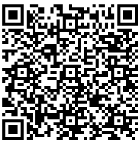
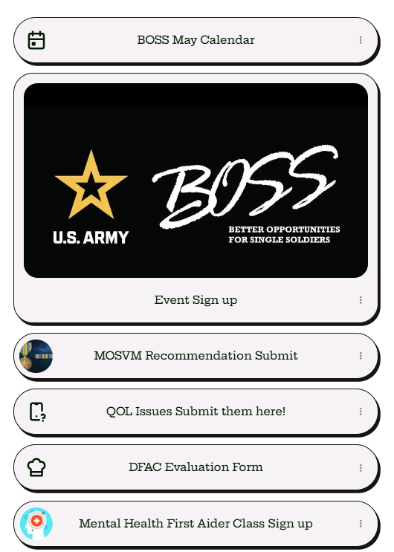
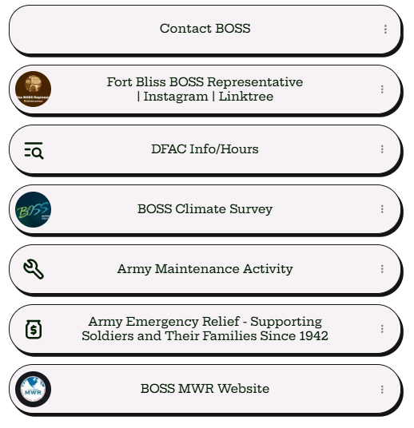
J. Skillern, 915-744-1529, patricia.a.skillern.naf@army.mil
26

Slide 27
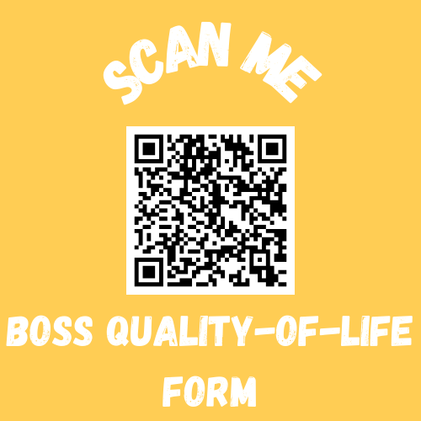
!!! Your Voice Matters !!!
If you are facing unresolved Quality of Life issues, you don’t have to deal with them alone. The BOSS program is here to take your concerns directly to leadership and fight for the changes you deserve.
What Can You Report?
• Barracks & Housing: Maintenance delays, safety, or facility conditions.
• Dining Facilities (DFAC): Food quality, hours, or accessibility.
• General QoL: Anything impacting your daily life and morale.
How It Works:
1. You Submit: Fill out the brief QoL form 2. We Advocate: BOSS leadership reviews and escalates the issue.
3. We Get Results: We track the issue until a resolution is reached.
Don't just complain, let us help you fix it!
J. Skillern, 915-744-1529, patricia.a.skillern.naf@army.mil
27

Slide 28

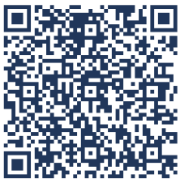
Fort Bliss BOSS Iron Zero Program
Free, safe, confidential rides for DOD card holders who shouldn’t drive due to alcohol use or impairment
Goal: Prevent DUI/DWI incidents and protect the safety, readiness, and wellbeing of the Fort Bliss community
When it operates:
Friday & Saturday (2200-0400)
Why it matters:
  Avoid losing on‑base driving privileges for one year
  Protect your career, your safety, and others
  Supports overall Soldier readiness
Run by: Fort Bliss BOSS
Request a ride: (915) 443‑6573
J. Skillern, 915-744-1529, patricia.a.skillern.naf@army.mil
28

Slide 29
Reoccurring BOSS Events
J. Skillern, 915-744-1529, patricia.a.skillern.naf@army.mil
29

Slide 30
2/1 AD Green Platoon Brief | BOSS
Purpose: Give Soldiers who are in-processing at Fort Bliss the opportunity to see the resources and activities available on base. Proponent: Fort Bliss BOSS Program Who: BOSS ( Better Opportunities for Single Soldiers)Geo Batchelor’s, Reserves. Closed to the Public population What: Quality of Life When: Every Thursday, Time; 1400-1500 Where: 20500 Cold War St, Fort Bliss, TX, 79918 Additional Information: BOSS Soldiers. Transportation Available Scope of support: BOSS Program, BOSS Reps, and Garrison Agencies. Uniform: Military Uniform, OCP or Unit PT Uniform POC: Fort Bliss BOSS President; SPC Chilcoat
ORDER / FRAGO # | O: N/A
Legal Review DTG | N/A
Estimated Cost | FREE
Mission Command (MC)
Occurrences
1,8,15,22,29 Oct | 2,9,16,23,30 Apr
6,13,20,27 Nov | 7,14,21,28 May
4,11,18,25 Dec | 4,11,18,25 Jun
1,8,15,21,29 Jan | 2,9,16,23,30 Jul
5,12,19,26 Feb | 6,13,20,27 Aug
5,12,19,26 Mar | 3,10,17,24 Sep
VIPs / Attendees
Guest Speakers, Sponsors, FMWR Programs can attend to brief new programming
Media
Linktree, Social Media Posts on Ft Bliss BOSS sites
Recommended Engagers
N/A
Key Message(s):
Desired Effect
Consistent information dissemination
J. Skillern, 915-744-1529, patricia.a.skillern.naf@army.mil
30

Slide 31
El Paso Community Clean up | BOSS
Purpose: Fort Bliss BOSS partnered with Visit El Paso to clean up downtown El Paso. BOSS Soldiers split into four groups with a representative from Visit El Paso in each group and picked up trash and debris from the sidewalks and benches. Soldiers shared stories, laughs, and insight into their day-to-day with each other. This is a great opportunity for Fort Bliss BOSS to reinforce our strong relationship with the El Paso community. Proponent: Fort Bliss BOSS Program Who: BOSS ( Better Opportunities for Single Soldiers)Geo Batchelor’s, Reserves. Closed to the Public population What: Volunteer Opportunity When: Second Saturday of Each Month, Time; 1000-1200 Where: 1 Civic Center Plaza, El Paso, TX, 79901 Additional Information: BOSS Soldiers. Transportation Available Scope of support: BOSS Program, BOSS Reps, MC, and Garrison Agencies. Uniform: Blue BOSS Shirt and comfortable Closed Toed Shoes, Military Uniform, OCP or Unit PT Uniform POC: Fort Bliss BOSS President; SPC Chilcoat
ORDER / FRAGO # | O: N/A
Legal Review DTG | N/A
Estimated Cost | $ FREE
Mission Command (MC)
Occurrences
10 Oct | 12 Apr
14 Nov | 09 May
12 Dec | 13 Jun
09 Jan | 11 Jul
13 Feb | 08 Aug
13 Mar | 12 Sep
VIPs / Attendees
N/A
Media
Linktree, Social Media Posts on Ft Bliss BOSS sites
Recommended Engagers
N/A
Desired Effect
Strengthen bond between El Paso Community and beautify El Paso.
Key Message(s): Litter Collection: Picking up trash and recyclables from streets, parks and public spaces in Downtown El Paso.
J. Skillern, 915-744-1529, patricia.a.skillern.naf@army.mil
31

Slide 32
Mental First Aid Training| BOSS
Purpose: Fort Bliss BOSS partnered with Emergence Health Network to become certified Mental Health First Aiders. BOSS Soldiers learned the importance of mental health in our lives and how to appropriately respond to someone facing a mental health struggle. BOSS Soldiers learned they are not there to diagnose mental health struggles but to help other Soldiers get the help they need. Proponent: Fort Bliss BOSS Program Who: BOSS ( Better Opportunities for Single Soldiers)Geo Batchelor’s, Reserves. What: Volunteer Opportunity When: See Occurrences for dates, Time; 0900-1300 Where: Emergence Health Network, 10737 Gateway Blvd, El Paso, TX, 79935 Additional Information: BOSS Soldiers. Registration MVPN: Mental Health First Aid (MHFA) for Fort Bliss SMVF Tickets, Multiple Dates | Eventbrite Scope of support: BOSS Program, BOSS Reps, MC, and Garrison Agencies. Uniform: Business casual, Military Uniform, OCP or Unit PT Uniform POC: Fort Bliss BOSS President; SPC Chilcoat
ORDER / FRAGO # | O: N/A
Legal Review DTG | N/A
Estimated Cost | $ FREE | Food and Drink
Mission Command (MC)
Occurrences
27 Oct | 29 Apr
25 Nov | 26 May
15 Dec | 30 Jun
27 Jan | 28 Jul
24 Feb | 25 Aug
31 Mar | 29 Sep
VIPs / Attendees
N/A
Media
Linktree, Social Media Posts on Ft Bliss BOSS sites
Recommended Engagers
BOSS Reps
Desired Effect
Provide Service members the tools to help support their fellow Service Members
Key Message(s):
J. Skillern, 915-744-1529, patricia.a.skillern.naf@army.mil
32

Slide 33
Monthly BOSS Representative Meeting
Purpose: To disseminate BOSS information to BDE,BN,CP/TRP BOSS Reps to plan, coordinate, and improve Quality of life initiatives for the single service member. Information Disseminated in this meeting is to be briefed to their respective leadership and Soldiers in their formations. Proponent: Fort Bliss BOSS Program Who: BOSS ( Better Opportunities for Single Soldiers)Brigade, Battalion, Company, Troop, and Squadron of all Military Branches Residing on Fort Bliss. Closed to the Public What: Quality of Life When: See Occurrences for dates, Time; 1300-1400 Where: 20732 Constitution Ave, Fort Bliss, TX 79918. Additional Information: BOSS Representative will be responsible for BOSS Program inspectable which will be discussed during monthly meetings. Each Bridge will be assigned a date in which these items will be inspected. Scope of support: BOSS Program, BOSS Reps, MC, and Garrison Agencies. Uniform: Military Uniform, OCP or Unit PT Uniform POC: Fort Bliss BOSS President; SPC Chilcoat
ORDER / FRAGO # | O: OPORD
Legal Review DTG | N/A
Estimated Cost | TBD
Mission Command (MC)
Occurrences
06 Oct | 07 Apr
03 Nov | 05 May
01 Dec | 02 Jun
13 Jan | 07 Jul
03 Feb | 04 Aug
10 Mar | 01 Sep
VIPs / Attendees
Guest Speakers, Sponsors, FMWR Programs can attend to brief new programming
Media
Linktree, Social Media Posts on Ft Bliss BOSS sites
Recommended Engagers
N/A
Key Message(s): BOSS Representative meetings are critical to ensure smooth dissemination of BOSS Program initiatives. It is mandatory that each BDE, BN Primary Representative attends. If they a
Desired Effect
Consistent information dissemination
J. Skillern, 915-744-1529, patricia.a.skillern.naf@army.mil
33

Slide 34
Newcomer’s Brief | BOSS
Purpose: Give Soldiers who are in-processing at Fort Bliss the opportunity to see the resources and activities available on base. Proponent: Fort Bliss BOSS Program Who: BOSS ( Better Opportunities for Single Soldiers)Geo Batchelor’s, Reserves. Closed to the Public population What: Quality of Life When: Every Thursday, Time; 1520-1530 Where: 11199 Sergeant E Churchill St. Additional Information: BOSS Soldiers. Transportation Available Scope of support: BOSS Program, BOSS Reps, MC, and Garrison Agencies. Uniform: Military Uniform, OCP or Unit PT Uniform POC: Fort Bliss BOSS President; SPC Chilcoat NCB POC: Mrs. Deana Garcia and Mr. Lara Manual
ORDER / FRAGO # | O: N/A
Legal Review DTG | N/A
Estimated Cost | FREE
Mission Command (MC)
Occurrences
1,8,15,22,29 Oct | 2,9,16,23,30 Apr
6,13,20,27 Nov | 7,14,21,28 May
4,11,18,25 Dec | 4,11,18,25 Jun
1,8,15,21,29 Jan | 2,9,16,23,30 Jul
5,12,19,26 Feb | 6,13,20,27 Aug
5,12,19,26 Mar | 3,10,17,24 Sep
VIPs / Attendees
Guest Speakers, Sponsors, FMWR Programs can attend to brief new programming
Media
Linktree, Social Media Posts on Ft Bliss BOSS sites
Recommended Engagers
N/A
Key Message(s):
Desired Effect
Consistent information dissemination
J. Skillern, 915-744-1529, patricia.a.skillern.naf@army.mil
34

Slide 35
Rescue Runners | BOSS
Occurrences
07 Oct | 05 Apr
02 Nov | 03 May
07 Dec | 07 Jun
04 Jan | 05 Jul
08 Feb | 02 Aug
01 Mar | 06 Sep
Purpose: Fort Bliss BOSS Soldiers volunteered with City of El Paso Animal Services to help walk shelter dogs. This volunteer opportunity gives the dogs much-needed love and exercise and gives BOSS Soldiers a unique volunteer experience working with animals. Volunteer opportunities like dog-walking support the community shelters, allow Soldiers to spend time with dogs, and further strengthens the relationship between Fort Bliss and the city of El Paso. Proponent: Fort Bliss BOSS Program Who: BOSS ( Better Opportunities for Single Soldiers)Geo Batchelor’s, Reserves. Closed to the Public population What: Volunteer Opportunity When: 1st Sunday of the month, Time; 0800-1000 (NOV-MAR 0900-1030 Winter Hours*) Where: 5001 Fred Wilson Ave. Fort Biss, TX 79904 and 9068 Socorro Rd. El Paso, TX 79907 Additional Information: BOSS Soldiers. Transportation Available Scope of support: BOSS Program, BOSS Reps, MC, and Garrison Agencies. Uniform: Tasteful Civilian Attire, Pants and closed toed shoes POC: Fort Bliss BOSS President; SPC Chilcoat
ORDER / FRAGO # | O: N/A
Legal Review DTG | N/A
Estimated Cost | $ FREE
Mission Command (MC)
VIPs / Attendees
BOSS Soldiers
Media
Linktree, Social Media Posts on Ft Bliss BOSS sites
Recommended Engagers
N/A
Desired Effect
Get Shelter animals our and adapted for adoption
Key Message(s): Dog Walking & Socialization- Exercising dogs, helping them get used to people, and improving behavior for adoption.
J. Skillern, 915-744-1529, patricia.a.skillern.naf@army.mil
35

Slide 36
Theater Thunder | BOSS
Purpose: Fort Bliss BOSS rolled out in their comfiest clothes for FREE Movie tickets at Freedom Crossing. This was a night of entertainment, laughs, and relaxation — a perfect way to unwind from work and connect with other BOSS Soldiers. Fort Bliss BOSS partners with AAFES to provide free movie tickets to our BOSS Soldiers, the only thing Soldiers pay for is their own snacks and drinks. This event helps the MGM Grand receive more business on their slowest day of the week and helps Soldiers unwind from work. Proponent: Fort Bliss BOSS Program Who: BOSS ( Better Opportunities for Single Soldiers)Geo Batchelor’s, Reserves. Closed to the Public population What: Recreation & Leisure When: See Occurrences for dates, Time; 1900-2300 Where: 1619 Pleasonton Rd, Fort Bliss,TX 79906 Additional Information: BOSS Soldiers. Transportation Available Scope of support: BOSS Program, BOSS Reps, MC, and Garrison Agencies. Uniform: Tasteful Civilian Attire POC: Fort Bliss BOSS President; SPC Chilcoat
ORDER / FRAGO # | O: N/A
Legal Review DTG | N/A
Estimated Cost | $ FREE | Food and Drink available for purchase.
Mission Command (MC)
Occurrences
13 Oct | 14 Apr
11 Nov | 12 May
16 Dec | 09 Jun
13 Jan | 14 Jul
10 Feb | 11 Aug
10 Mar | 08 Sep
VIPs / Attendees
BOSS Soldiers
Media
Linktree, Social Media Posts on Ft Bliss BOSS sites
Recommended Engagers
N/A
Key Message(s):
Desired Effect
J. Skillern, 915-744-1529, patricia.a.skillern.naf@army.mil
36

Slide 37

Fort Bliss DFMWR Mission: BOSS at the Boardwalk
Purpose: To support the Morale (QOL) for single, unaccompanied, and single parent Soldiers while encouraging and assisting them in identifying, planning, organizing, and conducting leisure and recreational activities of their preference. This Event would be a place of Duty for all single unaccompanied, and single parent Soldiers. Proponent: U.S Army Garrison Fort Bliss. Who: BOSS ( Better Opportunities for Single Soldiers) Closed to the Public What: On 25 SEP 26, Fort Bliss BOSS Program will conduct the 2026 BOSS Bash at Biggs Park on East Fort Bliss to recognize the single and unaccompanied Soldiers for their dedication and contribution to the Army's mission. When: 25 SEP 26; 1300-1600 Where: 11388 Sergeant Major Blvd, El Paso, TX 79918. Biggs Park Additional Information: Coney Island Themed BOSS Bash Price: Free for BOSS Soldiers Scope of support: BOSS Program, BOSS Reps, MC, and Garrison Agencies. Uniform: Black Tie, Formal Wear POC: Fort Bliss BOSS President; SPC Chilcoat
ORDER / FRAGO # | O: TBD
Legal Review DTG | N/A
Estimated Cost | TBD
Mission Command (MC)
VIPs / Attendees
Fort Bliss senior leaders, EP community leaders, Garrison Agencies, Qualified BOSS Service Members, Units
Media
GPAO; DFMWR Local and social media
Recommended Engagers
CG or Representative
Desired Effect
Create an event with full support of Division Leadership to ensure all BOSS Service Member available can attend.
Key Message(s): The BOSS Bash will promote morale and comradery for the installation. This event provides key garrison agencies access to Single Service Members to promote their information. This event can be used for recruiting as well as a showcase from products intended for Service Members.
This event will be both a physical fitness event and a fun event filled with competitions and prizes!
J. Skillern, 915-744-1529, patricia.a.skillern.naf@army.mil
37

Slide 38
The Exchange
Firehouse Subs
  Will be replacing the Subway in the mini mall on the corner of Sergeant Major BLVD & Old Ironside Ave
  Tentatively looking to open late summer 2026
  Will deploy additional food trucks to Global Reach Express
Panda Express – Global Reach location
  Grand Opening scheduled for 16 June at 1100
Alterations
  Grand Opening scheduled for 18 June at 1130
Round Table
  Replacing the Pizza Hut that was in the mini mall on the corner of Sergeant Major BLVD & Old Ironside Ave
  Tentatively looking to open mid-late June 2026
Cell Towers
  9 towers have been constructed on Ft Bliss
  All towers are now on air
  See attached map for location and carriers
Kelly Tolefree-Sarmiento– GM 915-562-8851 X 202 tolefreesarmiento@aafes.com

Slide 39
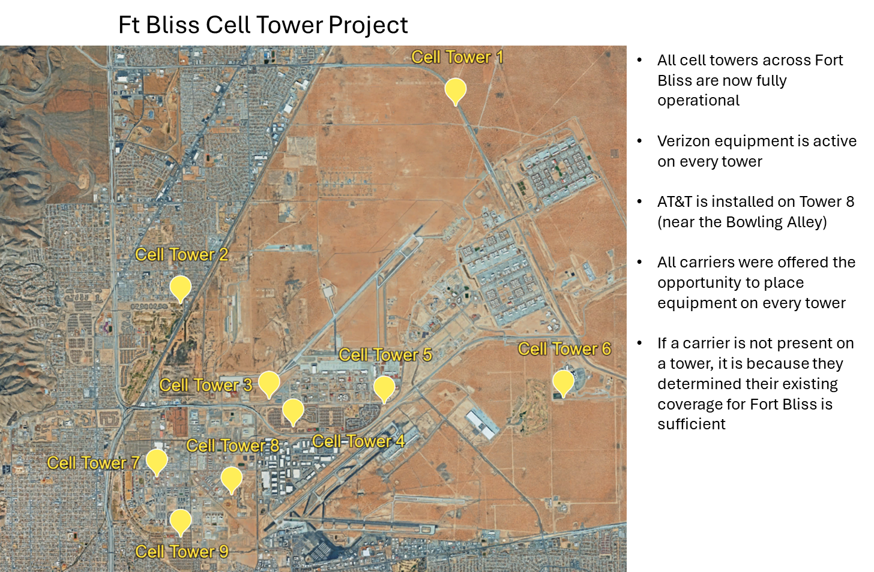
The Exchange
Kelly Tolefree-Sarmiento– GM 915-562-8851 X 202 tolefreesarmiento@aafes.com

Slide 40
The Exchange
Did you know?
  The Exchange is expanding shopping privileges to additional DoD civilians and Coast Guard members.
  This applies to Exchange stores in the United States and U.S. territories/possessions.
  To verify eligibility, associates must check the customer’s CAC card.
  The CAC must show:
    Affiliation as “Civilian”
    Agency/department as “DoD” or a Military Service branch
  Eligible individuals can only shop at the installations where they are employed.
  Access rules for foreign countries remain unchanged.
Kelly Tolefree-Sarmiento– GM 915-562-8851 X 202 tolefreesarmiento@aafes.com

Slide 41
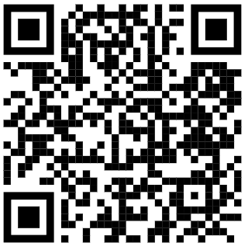


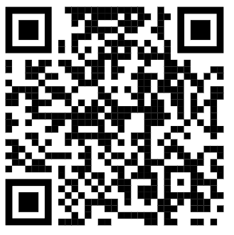

School Liaison Office
Bldg. 505 Pershing Rd.
Located inside the Solider Support Center
2026-27 Registration: Is your student signed up?
www.episd.org
www.canutillo-isd.org
www.yisd.net
www.sisd.net
www.clintweb.net
Let our offices help YOU, stop by today!
EPISD Graduation Dates & Information
EPISD Military Engagement
School’s Out Soon! Stay alert for increased child/youth activity in residential areas.
Last Day of School Reminders:
EPISD: 05 JUN 2026
Canutillo ISD: 28 MAY 2026
YISD: 29 MAY 2026
SISD: 04 JUN 2026
Clint ISD: 29 MAY 2026
Stephanie Chacon, DFMWR/CYS, 915-569-5064, stephanie.r.chacon.naf@army.mil

Slide 42

Ft. Bliss
Registrations available via Walk In/ Appointment
Appointments have priority, call and secure yours today.
915-568-4646
BLDG. 1743 VICTORY AVE.
(Open Monday Thru Friday 0800-1700)
All registration forms can be found on our website Or in our office.
http://www.bliss.armymwr.com
42

Slide 43
WHY REGISTER WITH CYS?
BENEFITS:
1.Emergency Child Care Needs- Spouse medical hospital emergency
2. SKIES/Sports Activities- Keep your children busy and active with swimming, dance, music, vocal classes, gymnastics, fencing, piano, guitar, cheerleading, art, soccer, baseball, football, basketball and many others
3. Parents Night Out/Day Out- Need a few hours to yourself to reset? Parents Day out can get you 7 hours to yourself while your children have fun in a safe environment.
4. Hourly Care available at 3 facilities Main, East Bliss, and Replica CDC. Along with FCC providers.
Children must be registered with CYS to participate. Registration is only once a year!
DEPLOYMENT
Register with CYS to receive up to 16 hours of childcare for Deployments
Full time care patrons may qualify for 20% off during deployments.
43

Slide 44

Registering Children with
Medical Conditions or children needing specific Accommodations
EXAMPLES: Asthma, Food Allergies, Respiratory Difficulties, Diabetes, Seizures, developmental delays, ADHD, Autism, Allergies requiring rescue medications, ODD, Speech Delay etc.
2. Registration: Complete the Registration Form and submit along with Health Assessment to CYS. Additional documentation may be needed (Medical Action Plans). Paperwork is sent to Public Health nurse for review a Multi-disciplinary Inclusion Action Team (MIAT) reviews and discusses best care options. MIAT can take up to 30 days to complete. Starting the process now saves you time later when you need services.
44

Slide 45
CHILD DEVELOPMENT CENTERS
1- East Bliss Child Development Center
Address: 20707 Kasserine Way, Fort Bliss, TX 79918
Phone#: 915-744-2731
2- Milam Child Development Center
Address: 11896 Haan Rd, Fort Bliss, TX 79908
Phone#: 915-744-7877
3-Logan Child Development Center
Address: 3500 Ellerthorpe Ave, El Paso, TX 79904
Phone#: 915-568-3989
4-Replica Child Development Center
Address: 5036 Sheridan Rd, El Paso, TX 79906
Phone#: 915-569-7196
5-Main Child Development Center
Address: 1730 Haan Rd, Fort Bliss, TX 79906
Phone#: 915-568-5689
45

Slide 46
SCHOOL AGE SERVICES
1- Bliss School Age Center (Bliss SAC)
Address: 2012 Sheridan Rd, Fort Bliss, TX 79906
Phone#: 915-568-2178
2-Milam School Age Center (Milam SAC)
Address: 11898 Haan Rd, Fort Bliss, TX 79916
Phone#: 915-744-1174
YOUTH CENTERS
1- Replica Youth Center
Address: 5037 Sheridan Rd, Fort Bliss, TX 79906
Phone#: 915-568-3523
2-Milam Youth Center
Address: 10960 Haan Rd, Fort Bliss, TX 79916
Phone#: 915-744-2449
46

Slide 47
Family Child Care (FCC)
Address: 3508 Ellerthorpe Ave, Fort Bliss, TX 79904
Phone#: 915-568-8840
SKIES
1-Address: 131A Doniphan rd, Fort Bliss, TX 79916
Phone#: 915-568-5544/7187
2-Address: 3508 Ellerthorpe Ave, Fort Bliss, TX 79916
Phone# 915-568-8336
YOUTH SPORTS PLEX
Address: 195 Chaffee Road, Fort Bliss, TX 79916
Phone#: 915-568-2617
47

Slide 48
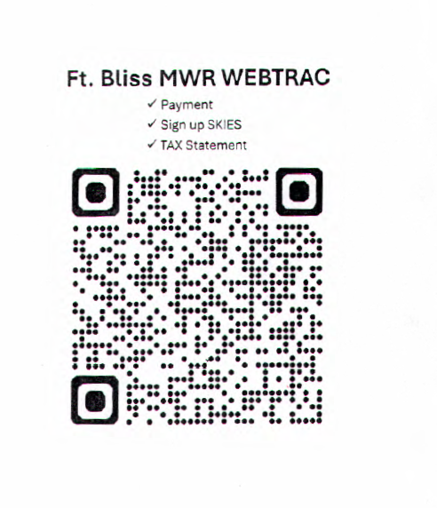
WEBTRACK QR CODE
48

Slide 49
Patient Information
William Beaumont Army Medical Center
School and Sports physicals will be available at the Mendoza Clinic 29 May to 30 July 2026; call the appointment line to schedule (915-742-2273). Please bring the necessary physical forms.
Patient and Family Partnership Council will be August 20, 2026 at 10:30 a.m. in the WBAMC Executive Dining Room
There are several Red Cross Volunteer opportunities available at the hospital. Call 915-742-9433 or email bliss@redcross.org
EFMP information briefs are held every 2nd & 4th Thursday of the month at 1:00 p.m. at the WBAMC West Clinic 3rd floor HR Conference Room (#W3414).
The Soldier Family Medical Center is closed for repairs. Please visit our website for the temporary locations for your primary care and ancillary care services. https://william-beaumont.tricare.mil/Clinics/Soldier-Family-Medical-Center-West-Bliss
Service Degradation – With the upcoming PCS season, please be aware that services provided within the MTF may fluctuate. We strive to provide quality, continuity, and safety to all of our patients and staff. We will communicate any changes that affect access to care promptly.
Kristal Pinkney, 915-742-3878, kristal.a.pinkney.civ@health.mil
49

Slide 50
Patient Information
William Beaumont Army Medical Center
Ongoing
TRICARE Active Duty to Retiree Briefing is every 3rd and 4th Tuesday of the month at 2:00 p.m., 5th Floor East Clinic, Referral Management
Children’s Waiting Rooms (CWR) are by appointment only; Please call 915-742-9926/0975. Hours are Monday to Friday 8:00 a.m. to 12:00 p.m. at WBAMC and 1:00 p.m. to 4:30 p.m. at Mendoza.
Your feedback is important; please take the time to fill out your JOES and TRISS surveys.
Visit our website for current information: https://williambeaumont.tricare.mil
Kristal Pinkney, 915-742-3878, kristal.a.pinkney.civ@health.mil
50

Slide 51
Kristal Pinkney, 915-742-3878, kristal.a.pinkney.civ@health.mil
51

Slide 52

Kristal Pinkney, 915-742-3878, kristal.a.pinkney.civ@health.mil
52

Slide 53

53

Slide 54
Vaccine Walk-In Capability
Mendoza FCC, SCC, and SFMC (Garrison)
  Walk in available Monday-Friday daily from 0800-1100 and 1300-1500
  Closed 2nd and 4th Thursday of the month after noon due to training
  *Mendoza Soldier Care Clinics (Garrison & SCC): Please call ahead to
  915-742-0965 to ensure availability
  *SFMC (Garrison) empaneled patients report to Mendoza SCC to receive immunizations
  East Bliss
  Walk in available Monday – Friday daily from 1300-1500
  Closed 2nd and 4th Thursday of the month afternoon due to training
Mendoza Peds
  By appointment only
  Flu vaccines available for children ages 6 months and up
  Vaccines can also be given if at clinic for another appointment reason
Rio Bravo
  Walk in available daily from 0800-1100 and 1330-1430
  Closed 2nd and 4th Thursday of the month afternoon due to training
  ** Soldier Care Clinics (i.e. Mendoza Soldier, East Bliss, SFMC [garrison]) receive flu vaccine with unit during planned mass administration; if not able, walk in clinic available
Kristal Pinkney, 915-742-3878, kristal.a.pinkney.civ@health.mil
54

Slide 55
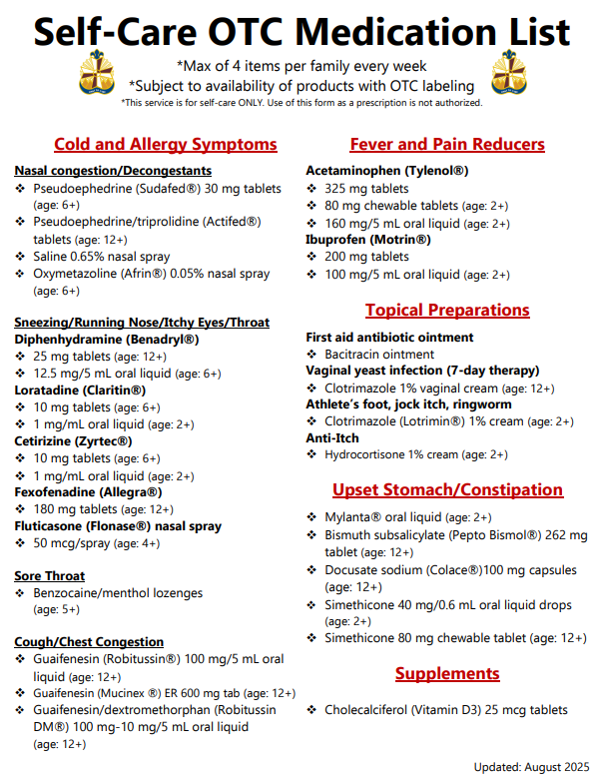
Kristal Pinkney, 915-742-3878, kristal.a.pinkney.civ@health.mil
55

Slide 56
Kristal Pinkney, 915-742-3878, kristal.a.pinkney.civ@health.mil
56

Slide 57

Kristal Pinkney, 915-742-3878, kristal.a.pinkney.civ@health.mil
57

Slide 58


Slide 59


Slide 60


Slide 61


Slide 62


Slide 63


Slide 64


Slide 65
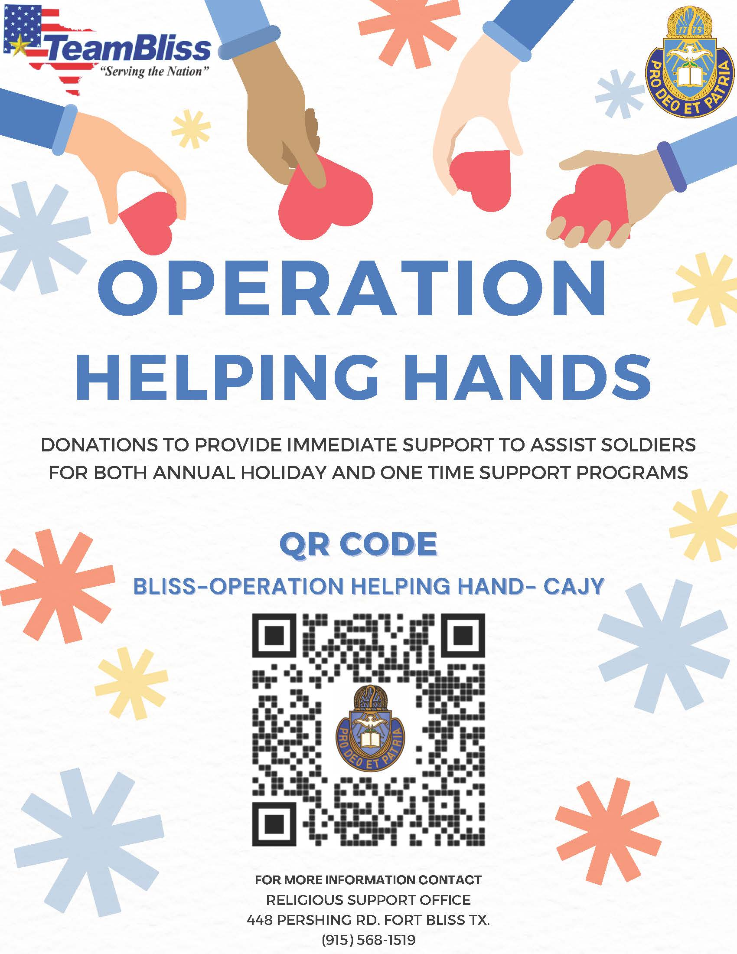

Slide 66


Slide 67


Slide 68


Slide 69


Slide 70

El Paso MOAA exists to:
Promote the purposes of MOAA National to:
  Inculcate and stimulate love of our country and the flag
  Defend the honor, integrity and supremacy of the national government and Constitution of the United States
  Further the education of military dependents
Facilitate camaraderie among chapter members
Support the legislative agendas of National MOAA and other El Paso area VSOs that provide services to and protect the interests of the veteran's community
Aid members and members’ interests in every possible way allowed by the chapter by-laws
El Paso MOAA Provides:
Two opportunities for college financial assistance in partnership with MOAA National:
  The 1st Armored Division- El Paso Chapter Scholarship
  The Colonel Joseph C Rodriguez, Medal of Honor, Memorial Scholarship
The Velton Locklear, Jr. Memorial Scholarship through the El Paso Community Foundation
Timely email alerts on local and national matters of interest to include updates on key legislation, health affairs, etc.
Support to Ft Bliss community and El Paso area non-profits and, schools
  Recognition of outstanding El Paso area high school JROTC cadets and UTEP senior cadets
  Welcome of newly commissioned UTEP ROTC cadets into the Profession of Arms via our shoulder board/”butter bar” program
  Sponsorship of local Armed Services YMCA, Ft Bliss SKIES, Soldier Art Workshops and other events/activities
Recognize Ft Bliss Officers via the MG Greer Iron Major Award and BG Kotter Jr Officer Award
Quarterly member lunches featuring speakers’ presentations on relevant issues
Our quarterly, award-winning publication, The Border Bulletin
El Paso MOA
Needs You and You Need
El Paso MOAA
Robert Wagner, 414-550-9215, rmwdmw@gmail.com
70

Slide 71

Destination El Paso
Check out our events calendar!
New templates found at:
HQ Public Affairs - IMCOM SLIDE TEMPLATES - All Documents (sharepoint-mil.us)
2X versions (standard, widescreen)
  IMCOM internal
  For briefing AMC
INSTRUCTIONS ON USING THE SLIDES
Go the PAO Sharepoint and click on the Army Branding button.
Click on the IMCOM SLIDE TEMPLATES folder
Choose the 4:3 format.
Once you have your presentation chosen, choose Download to download it to your desktop.
  IMPORTANT: PLEASE DO NOT WORK OUT OF THE SHAREPOINT FILE!
On the title slide, name your briefing. Update the date in the lower left corner of the title slide.
Dania Bandas, Military Liaison, dbandas@destinationelpaso.com, 315-836-5736

Slide 72

Destination El Paso
Upcoming Events
Dania Bandas, Military Liaison, dbandas@destinationelpaso.com, 315-836-5736

Slide 73

Destination El Paso
Upcoming Event
Does that make sense?
Dania Bandas, Military Liaison, dbandas@destinationelpaso.com, 315-836-5736

Slide 74

Destination El Paso
Upcoming Event
Does that make sense?
Dania Bandas, Military Liaison, dbandas@destinationelpaso.com, 315-836-5736

Slide 75

Destination El Paso
Upcoming Event
Dania Bandas, Military Liaison, dbandas@destinationelpaso.com, 315-836-5736

Slide 76

Destination El Paso
Upcoming Event
Dania Bandas, Military Liaison, dbandas@destinationelpaso.com, 315-836-5736

Slide 77

Destination El Paso
Upcoming Event
Does that make sense?
Dania Bandas, Military Liaison, dbandas@destinationelpaso.com, 315-836-5736

Slide 78

Destination El Paso
Upcoming Event
Does that make sense?
Dania Bandas, Military Liaison, dbandas@destinationelpaso.com, 315-836-5736

Slide 79

Destination El Paso
Upcoming Event
Does that make sense?
Dania Bandas, Military Liaison, dbandas@destinationelpaso.com, 315-836-5736

