Slide 1
Mickelsen Library Guide to Overdrive
How to Access Online Resources

Slide 2
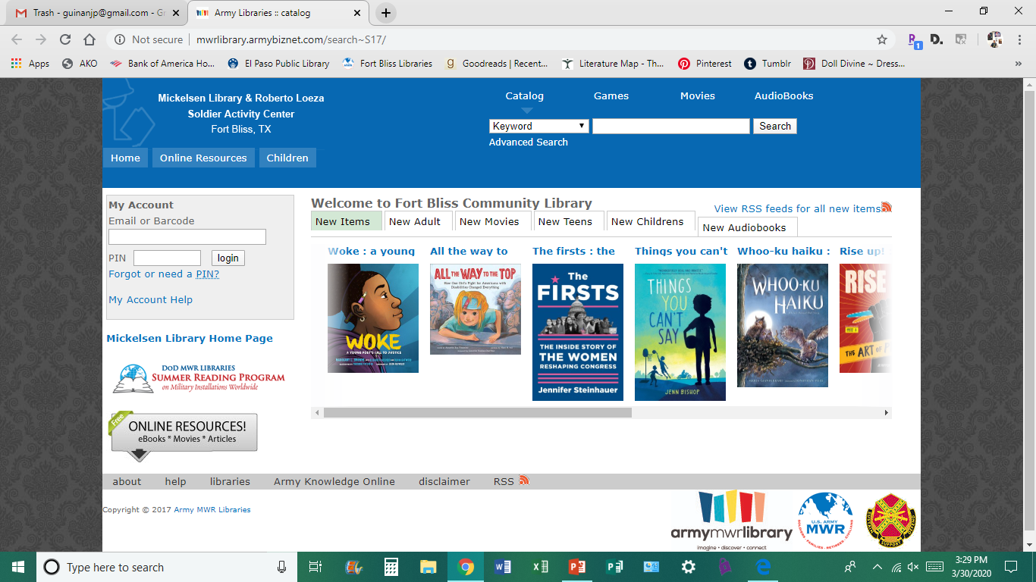
Accessing Mickelsen Library Catalog
1
2
Link to Mickelsen Library Catalog
Link to Online Resources
Click on Online Resources to access Overdrive (eBooks, eAudiobooks & eVideos) or RB Digital (eBooks, eAudiobooks, Magazines & Comics)
Catalog Link: http://mwrlibrary.armybiznet.com/search~S17/
Online Resources Link: http://mwrlibrary.armybiznet.com/screens~S17/resources.html

Slide 3
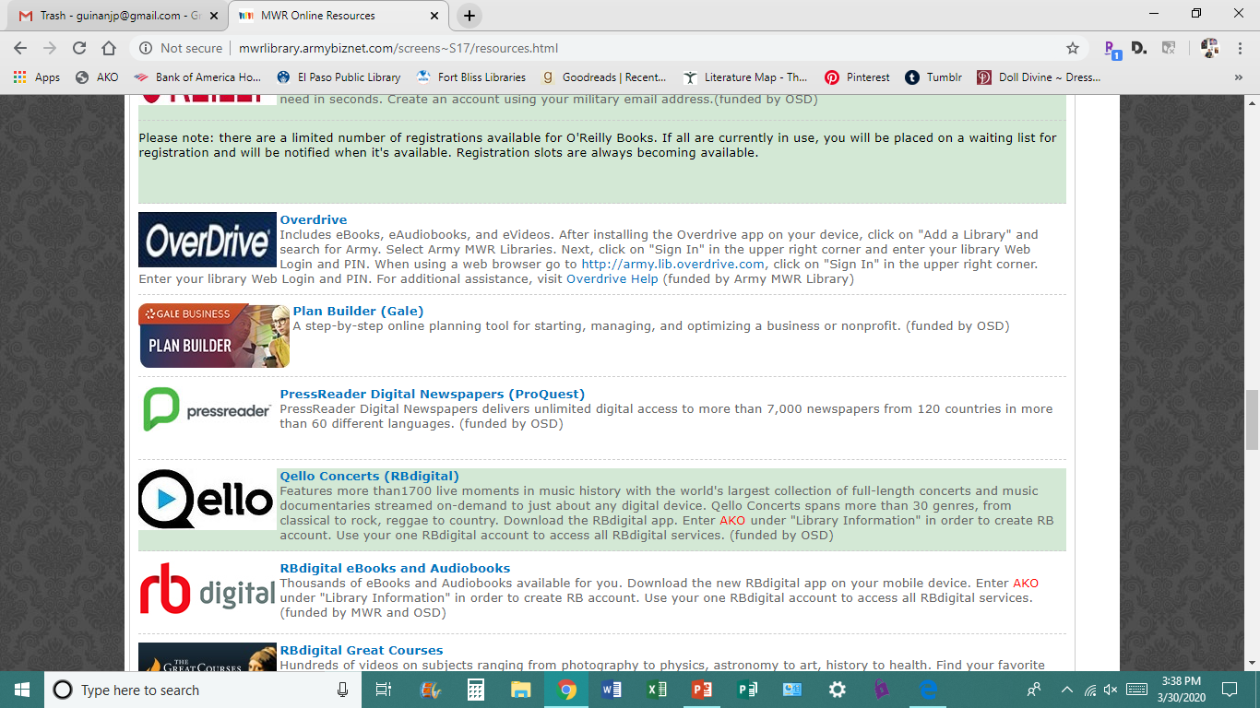
Accessing Overdrive & RB Digital
1
Links on the Online Resources page are in alphabetical order. Scroll down until you see:
OverDrive
RB Digital
First we will discuss OverDrive. Click on the link
2

Slide 4
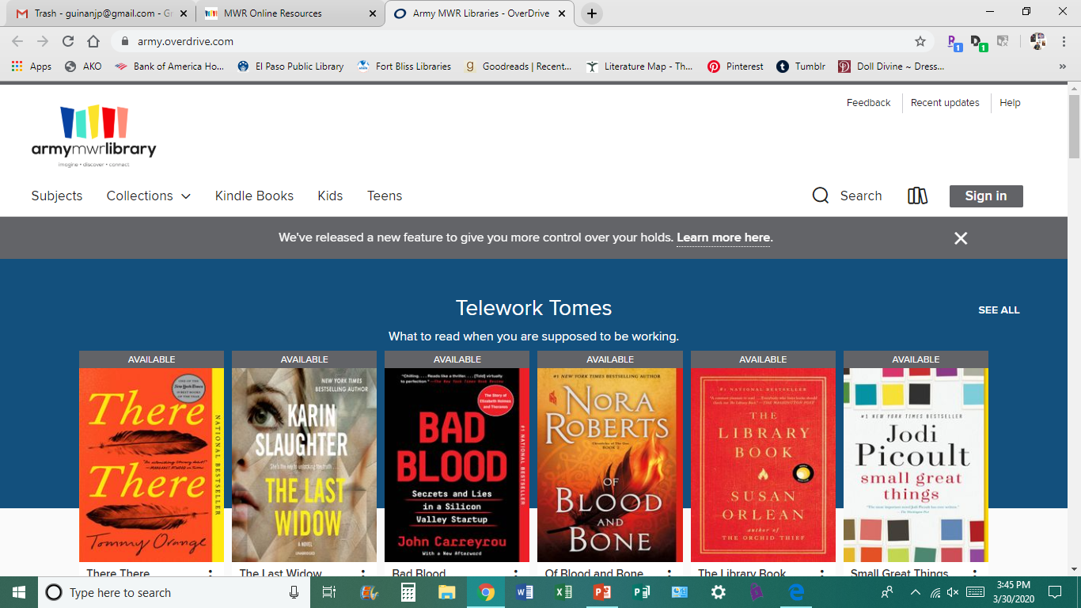
Accessing Overdrive
1
This is the OverDrive home page.
Sign In is in the upper right corner, click on it

Slide 5
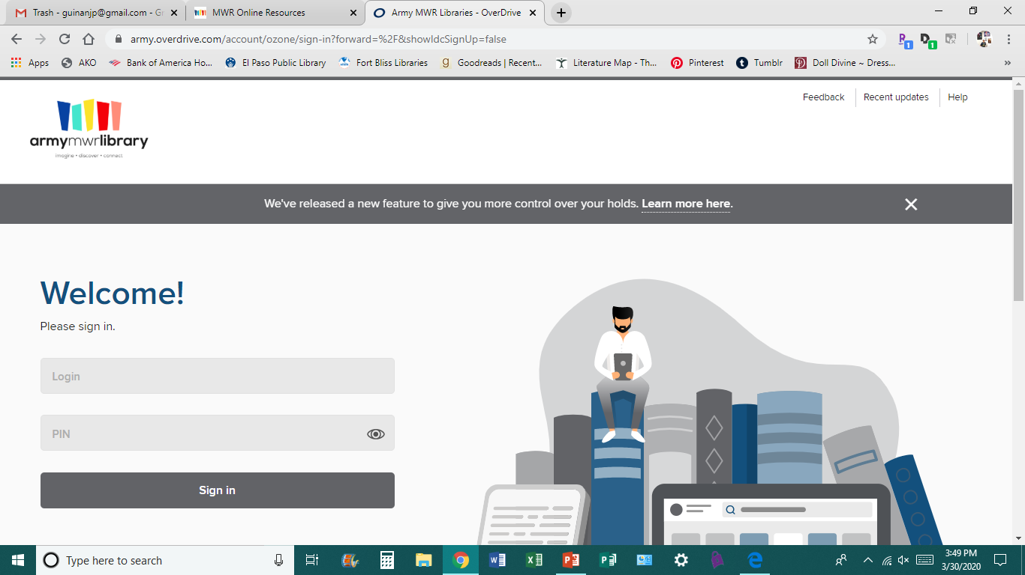
Accessing Overdrive
Here you must enter the email, and PIN number, you provided when filling out the card for your Full Service Library Account
1

Slide 6
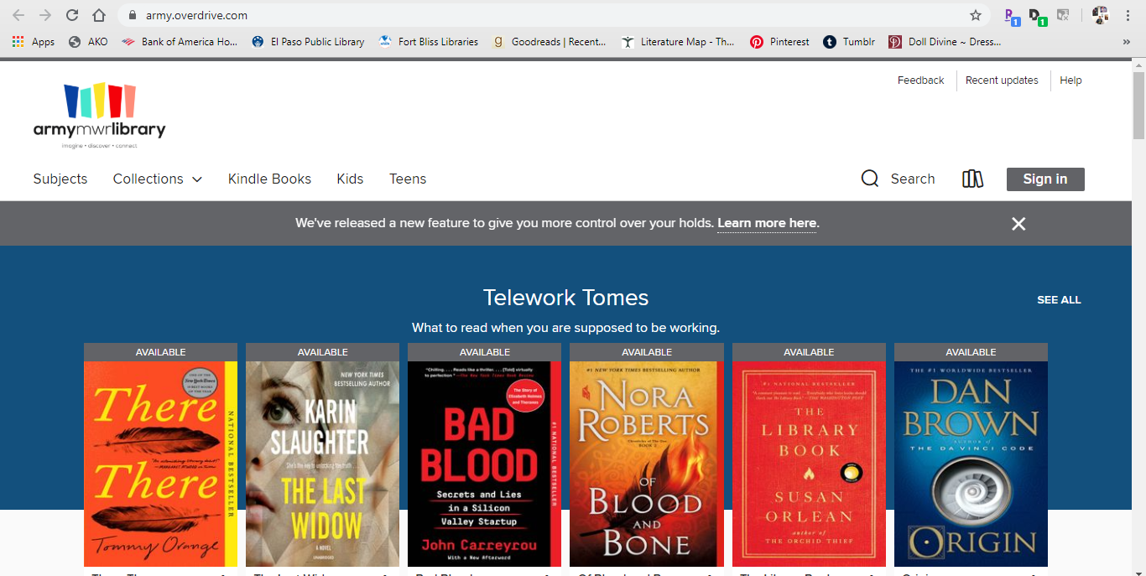
Accessing Overdrive
1
Once you have signed in you can search for materials, or access your account (the Three Book Symbol) to the right of Search where you can see items you have downloaded, or items waiting to be delivered
Find a title you like and click on it.

Slide 7
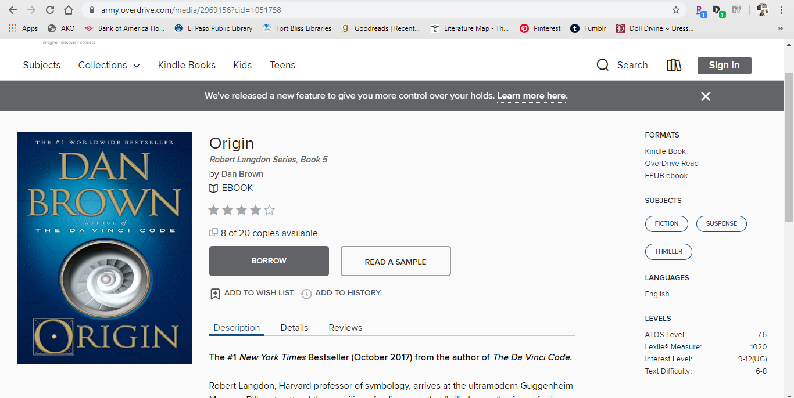
Accessing Overdrive
2
From the title’s page you can:
1.Choose to Borrow it, or Read a Sample
2. This box tells you what formats the item is available in (If you choose Kindle, you will be redirected to your Amazon account to finish downloading)
1

Slide 8
Accessing Overdrive
If you choose to Borrow your chosen title, click on the Borrow button
You will be taken to a page where you can select the format of the material you would like to borrow
Once you choose your format, you will be walked through Downloading instructions
When your item downloads, you are ready to read!!

Slide 9
Accessing RB Digital
Now we will discuss RB Digital. From the Online Resources page:
1. Click on the link for RB Digital
1

Slide 10
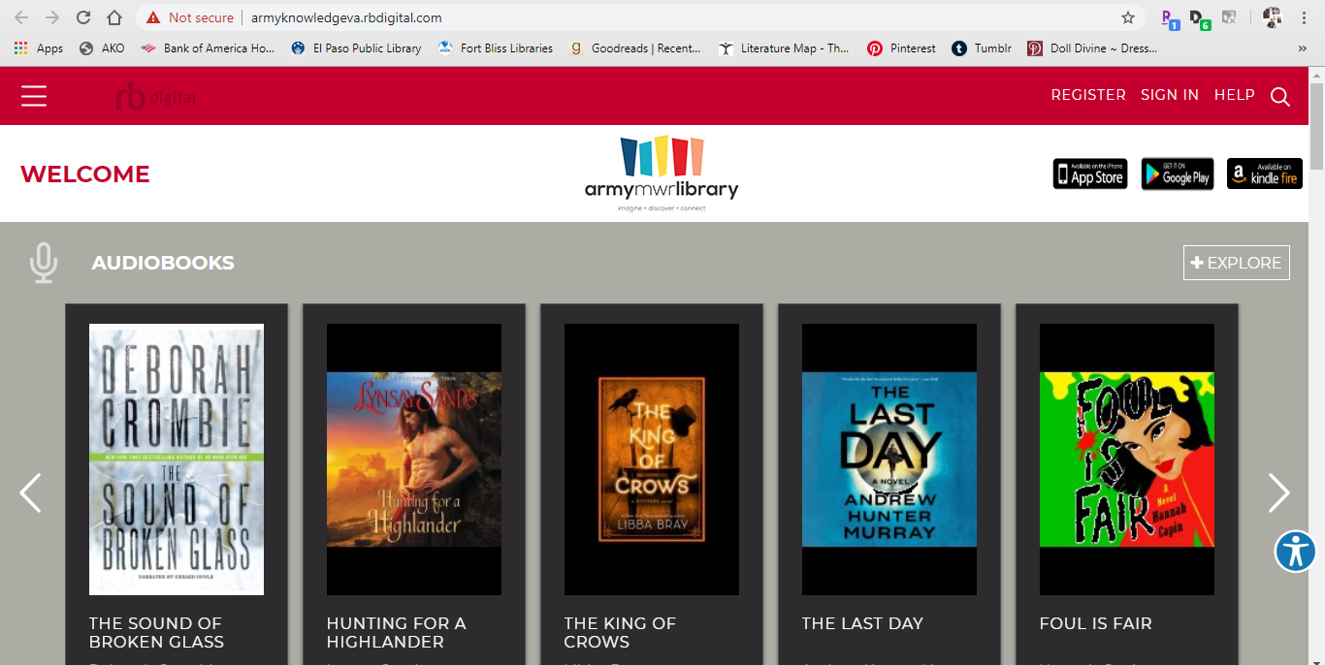
Accessing RB Digital
1
This is the RD Digital Homepage
Here is where you can Register for an RB Digital Account, if you do not have one, or Sign In if you do. The Search feature is the magnifying glass symbol in the upper right hand corner
Once you find a title you like, click on it, the words in white type

Slide 11
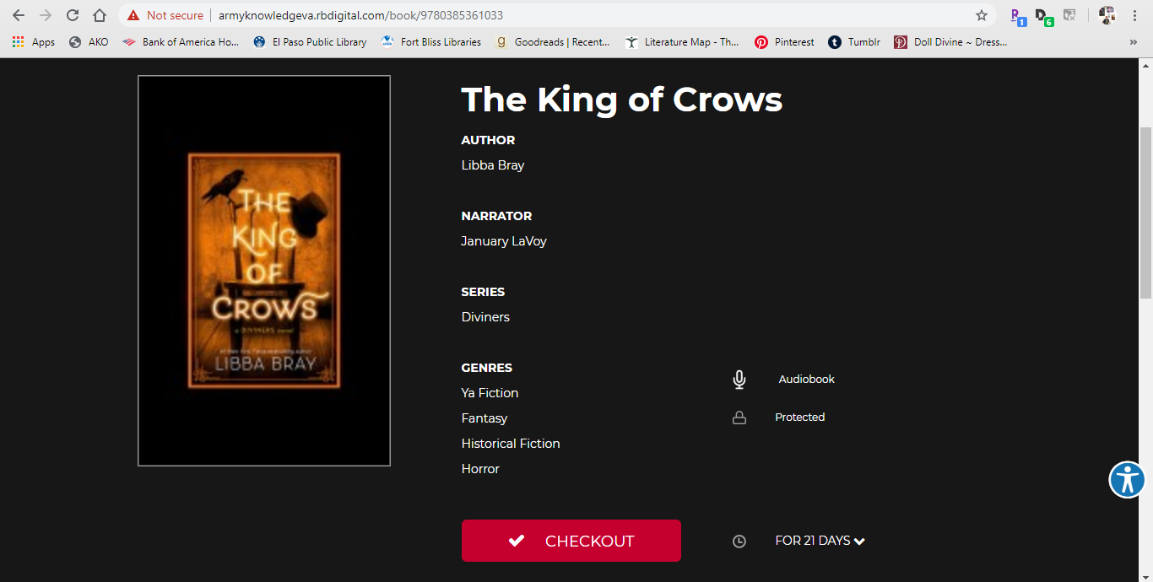
Accessing RB Digital
This is the title’s homepage. From here you can see information on the title, and, if you like it:
1. Checkout your title

Slide 12
Obtaining a Library Account If You Do Not Have One
If you would like an Army Library Account to access these online resources, and do not have one, please send an email to the account below:
usarmy.mwr.library@mail.mil
It is being monitored by people that can assist you in creating an account
Happy Reading!!!

